Slide 1
Status update

Slide 2
Things I did:
Read about transformers (encoder decoder architectures, decoder/encoder architectures.)
Read about BERT
Generally more structuralized search for related work.
Currently doing:
Taking a hugging face course.

Slide 3
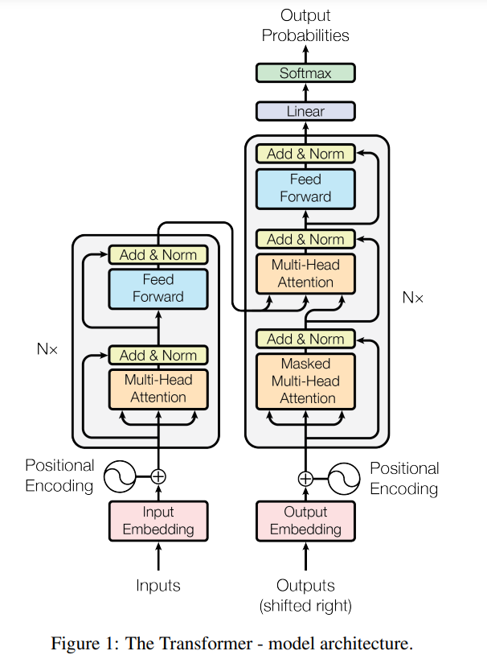
What I know about transformers

Slide 4
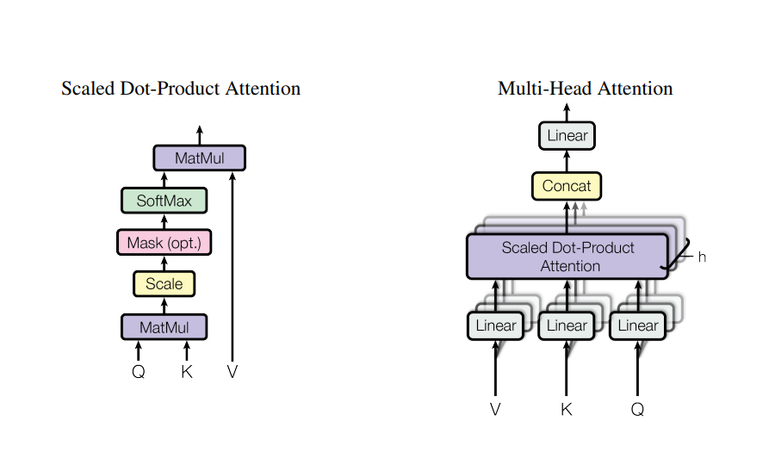
What I know about transformers

Slide 5
What I don’t understand about transformers
Is my idea of the parallelization issue correctly understood?

Slide 6
What I don’t understand about transformers
Is my idea of the parallelization issue correctly understood?
Feel like there is an entire world of neural network normalization techniques that I haven’t grasped?

Slide 7
What I don’t understand about transformers
Is my idea of the parallelization issue correctly understood?
Feel like there is an entire world of neural network normalization techniques that I haven’t grasped?
Dimensionalities for the inputs for the scaled dot-product attention head.

Slide 8
What I don’t understand about transformers
Is my idea of the parallelization issue correctly understood?
Feel like there is an entire world of neural network normalization techniques that I haven’t grasped?
Dimensionalities for the inputs for the scaled dot-product attention head.
Positional encoding using sinusoidal functions of different frequencies.

Slide 9
BERT - Bi-directional encoder representations transformers
Pre-training
Bi-directionality
TASK 1: Masked LM
TASK 2: NSP (Next sentence prediction)

Slide 10
What I don’t understand with bert
Task 1: both the problem with masked LM, and the solution, is both weird.

Slide 11
General search for related work

Slide 12
“robot commands with natural language processing”

Slide 13
“robot commands with natural language processing”
☹

Slide 14
“robot commands with natural language processing”
HRI theory
General efficient communication
Not natural language processing relevant

Slide 15
“robot language commands using neural network”

Slide 16
“robot language commands using neural network”
sort by citations [by papers]
Publication topics:
- Speech recognition
- Natural language processing
- Neural nets (recurrent, convolutional, and feed forward)
- AI
- Intelligent robots
- Natural language
- Natural language interfaces.
- Mobile robots
- Control engineering
- Gesture recognition
- Robot vision

Slide 17
“robot language commands using neural network”
Automatic Translation of Spanish Natural Language Commands to Control Robot Comands Based on LSTM Neural Network:
Using RNN encoder-decoder structure to translate spoken text into Robot control language (non interpretable simplistic language form)
End result is action classification to one of seven actions
Data augmentation, as words in sentence action pairs, was exchanged with synonyms to create more sentenced.

Slide 18
“robot language commands using neural network”
Approximate Decision Making by Natural Language Commands for Robots
Bin picking task, sentences is used to locate object.
Uses a fuzzy controller and a neural network
Main interest, it uses user feedback also, to train its neural network, such to learn better parameters on the fly

Slide 19
A little bit more related work
Development of Indonesian Speech Recognition with Deep Neural Network for Robotic Command:
Uses a normal feed forward neural network to categorize words directly into one of six different actions.
Much more audio focused, than what I have planned.
Commanding mobile robot movement based on natural language processing with RNN encoder­decoder:
Uses a pre-processing step for filtering uninformative words,
the process afterwards using an RNN encoder decoder model, which gives probabilities for each action,
Post-processing to map the best suited action with its parameters into code.

Slide 20
Conclusions which can be drawn
Use of action categorization
Use of recurrent neural network instead of transformers models (BERT’s)
What I want to achieve
Hopefully uncategorized actions of some kind.
Implement language model based on transformers

Slide 21
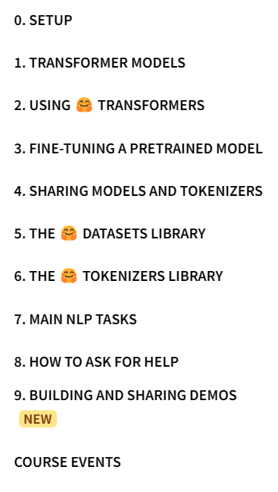
Hugging face course

Slide 22
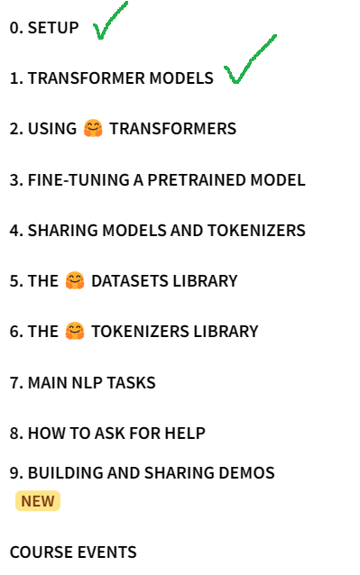
Hugging face course

Slide 23
robot language commands using transformers
Literature found afterwards
Reshaping Robot Trajectories Using Natural Language Commands: A Study of Multi-Modal Data Alignment Using Transformers | IEEE Conference Publication | IEEE Xplore (sdu.dk)

